Slide 1

Algebra 1
Unit 1, Lesson 7 Evaluating Exponential Expressions Volume 1, pg. 36

Slide 2


Benchmark
MA.912.NSO.1.1
Extend previous understanding of the Laws of Exponents to include rational exponents. Apply the Laws of Exponents to evaluate numerical expressions and generate equivalent numerical expressions involving rational exponents.
volume 1, pg. 36

Slide 3
Integrated Mathematical Thinking and Reasoning Standards
MA.K12.MTR.2.1 Demonstrate understanding by representing problems in multiple ways.
MA.K12.MTR.5.1 Use patterns and structure to help understand and connect mathematical concepts.
MA.K12.MTR.6.1 Assess the reasonableness of solutions.
volume 1, pg. 36

Slide 4

Learning Targets
I can evaluate numerical expressions involving rational exponents.
I can generate equivalent numerical expressions involving rational exponents.
volume 1, pg. 36

Slide 5

Warm-Up
volume 1, pg. 37

Slide 6
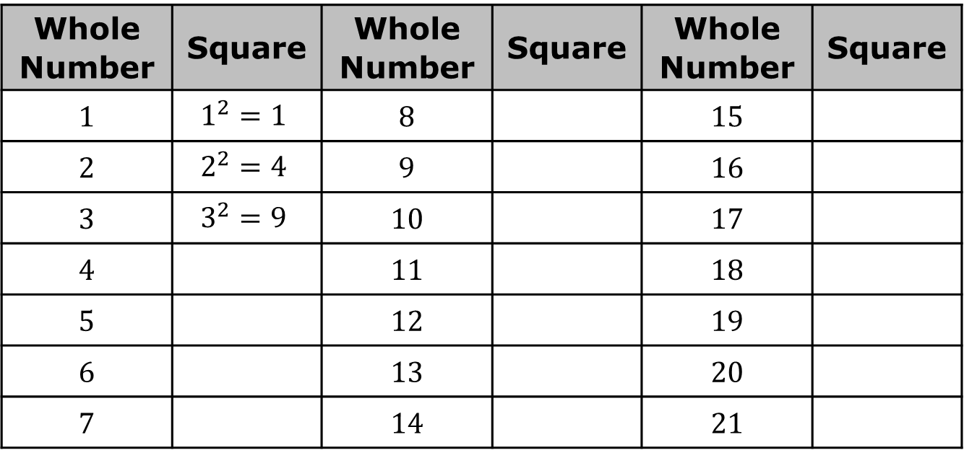
1.7.1 Warm-Up: Perfect Squares Puzzle
Complete the table by finding the square of each whole number.
Whole Number | Square | Whole Number | Square | Whole Number | Square
1 | $$1^{2}=1$$ | 8 |  | 15
2 | $$2^{2}=4$$ | 9 |  | 16
3 | $$3^{2}=9$$ | 10 |  | 17
4 |  | 11 |  | 18
5 |  | 12 |  | 19
6 |  | 13 |  | 20
7 |  | 14 |  | 21
volume 1, pg. 37
Notes:
Video Link: https://algebranation.wistia.com/medias/fi4fidi5y8

Slide 7
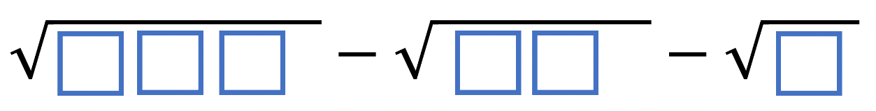
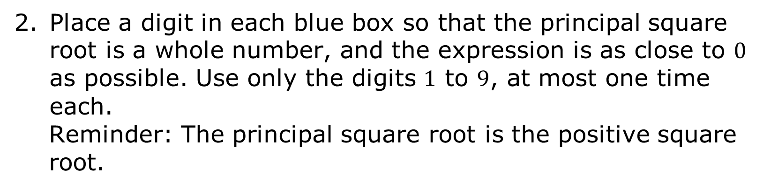
Place a digit in each blue box so that the principal square root is a whole number, and the expression is as close to $0$ as possible. Use only the digits $1$ to $9$, at most one time each.
Reminder: The principal square root is the positive square root.
volume 1, pg. 37

Slide 8

Collaboration
volume 1, pg. 37

Slide 9

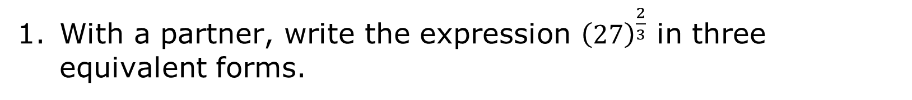
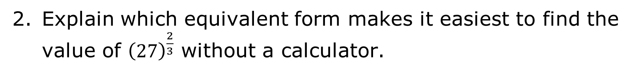
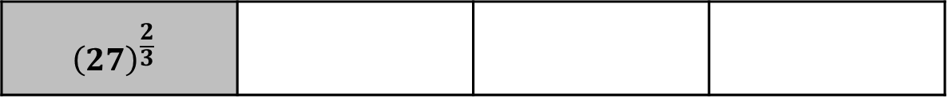
1.7.2 Collaboration: Simplifying Expressions with Exponents
With a partner, write the expression ${\left(27\right)}^{\frac{2}{3}}$ in three equivalent forms.
$${\left(27\right)}^{\frac{2}{3}}$$
Explain which equivalent form makes it easiest to find the value of ${\left(27\right)}^{\frac{2}{3}}$ without a calculator.
volume 1, pg. 37

Slide 10

Find the value of ${\left(27\right)}^{\frac{2}{3}}$ without a calculator.
Verify the value of ${\left(27\right)}^{\frac{2}{3}}$ using your calculator.
volume 1, pg. 37

Slide 11
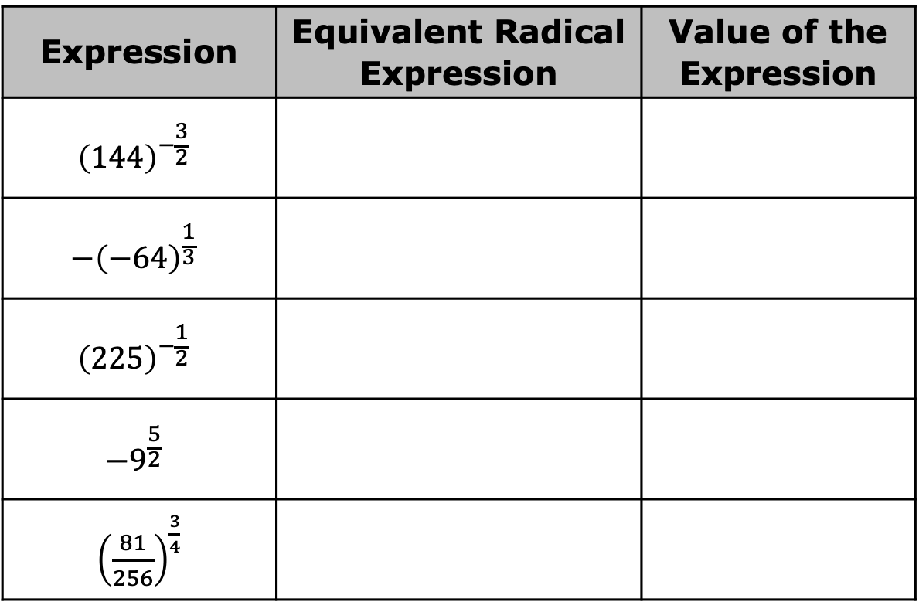
For each expression, write an equivalent radical expression. Then, evaluate the expression using your calculator.
Expression | Equivalent Radical Expression | Value of the Expression
$${\left(144\right)}^{−\frac{3}{2}}$$
$$−{\left(−64\right)}^{\frac{1}{3}}$$
$${\left(225\right)}^{−\frac{1}{2}}$$
$$−9^{\frac{5}{2}}$$
${\left(\frac{81}{256}\right)}^{\frac{3}{4}}$
volume 1, pg. 38

Slide 12

Activity
volume 1, pg. 38

Slide 13

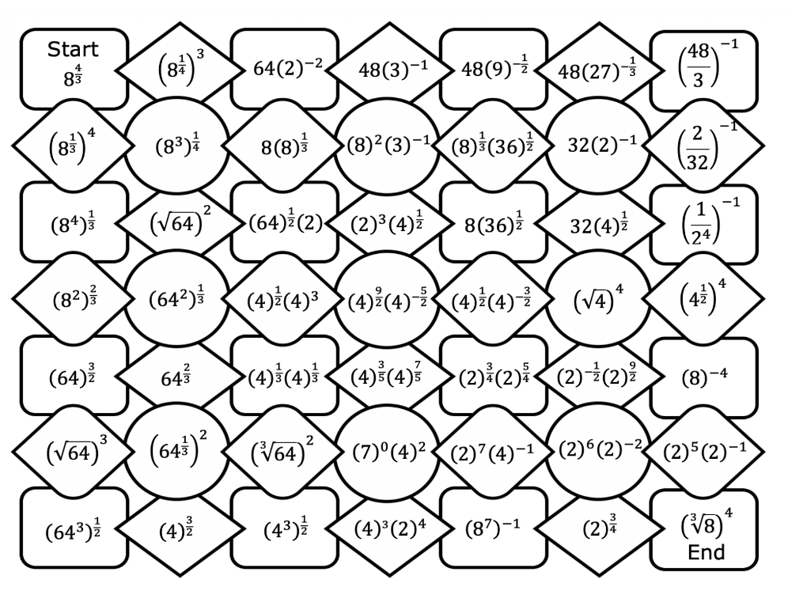
1.7.3 Activity: Exponents Maze
Work with a partner to complete the maze. Beginning at the “start” box, connect each expression to an equivalent expression to form one continuous path to the “end” of the maze. Move only horizontally or vertically.
volume 1, pg. 38

Slide 14
What is the value of the expression in each box that created the path through the maze?
volume 1, pg. 38

Slide 15

Your Turn
volume 1, pg. 39

Slide 16

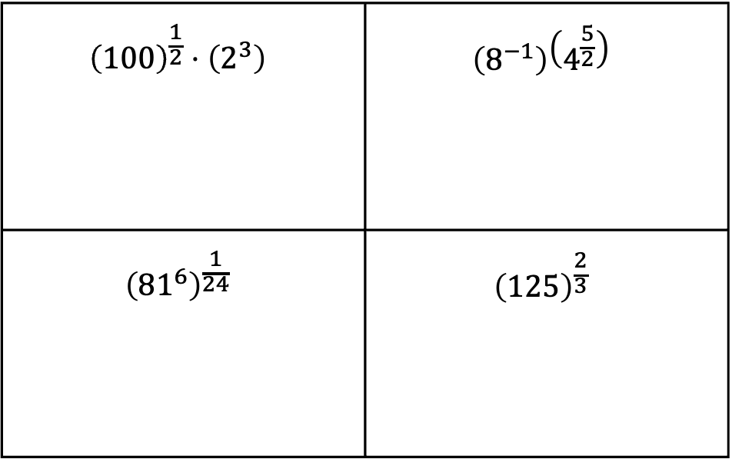
1.7.4 Your Turn!
Evaluate each expression without a calculator.
$${\left(100\right)}^{\frac{1}{2}}⋅\left(2^{3}\right)$$ | $$\left(8^{−1}\right)\left(4^{\frac{5}{2}}\right)$$
$${\left({81}^{6}\right)}^{\frac{1}{24}}$$ | $${\left(125\right)}^{\frac{2}{3}}$$
volume 1, pg. 39

Slide 17
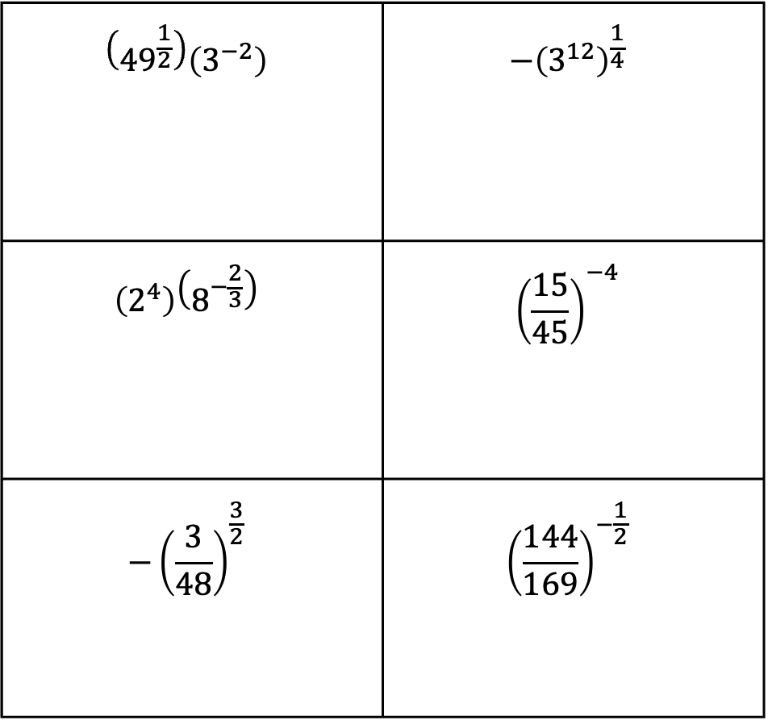
$$\left({49}^{\frac{1}{2}}\right)\left(3^{−2}\right)$$ | $${−\left(3^{12}\right)}^{\frac{1}{4}}$$
$$\left(2^{4}\right)\left(8^{−\frac{2}{3}}\right)$$ | $${\left(\frac{15}{45}\right)}^{−4}$$
$${−\left(\frac{3}{48}\right)}^{\frac{3}{2}}$$ | $${\left(\frac{144}{169}\right)}^{−\frac{1}{2}}$$
volume 1, pg. 39

Slide 18

Wrap-Up
volume 1, pg. 39

Slide 19
1.7.5 Wrap-Up: Reflection
Complete the following statements about today’s lesson.
Today I am still unsure about …
To fill in this gap I intend to …
volume 1, pg. 39

